Slide 1
Five Kingdom Classifications
Project by:
Aryan
Zohaan
Priyansh

Slide 2
Class Amphibian
Amphibians are ectothermic, tetrapod vertebrates of the class Amphibia. All living amphibians belong to the group Lissamphibia. They inhabit a wide variety of habitats, with most species living within terrestrial, fossorial, arboreal or freshwater aquatic ecosystems. Thus amphibians typically start out as larvae living in water, but some species have developed behavioral adaptations to bypass this.
The young generally undergo metamorphosis from larva with gills to an adult air-breathing form with lungs. Amphibians use their skin as a secondary respiratory surface and some small terrestrial salamanders and frogs lack lungs and rely entirely on their skin. They are superficially similar to lizards but, along with mammals and birds, reptiles are amniotes and do not require water bodies in which to breed. With their complex reproductive needs and permeable skins, amphibians are often ecological indicators; in recent decades there has been a dramatic decline in amphibian populations for many species around the globe.

Slide 3
Class Amphibian
The earliest amphibians evolved in the Devonian period from sarcopterygian fish with lungs and bony-limbed fins, features that were helpful in adapting to dry land. They diversified and became dominant during the Carboniferous and Permian periods, but were later displaced by reptiles and other vertebrates. Over time, amphibians shrank in size and decreased in diversity, leaving only the modern subclass Lissamphibia.

Slide 4
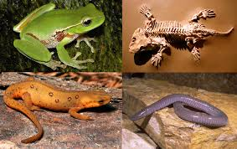
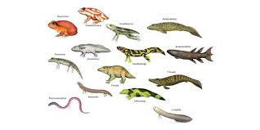
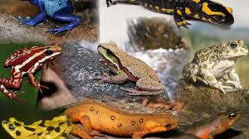
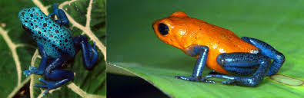

Slide 5
Class reptila
Reptiles are completely adapted to life on land. Their eggs have a leathery shell. They breathe by the means of their lungs right from their birth. They have rough thorny scales on the skin and a three chambered heart in which the ventricle is partially divided. They are cold blooded. Reptiles are tetrapod animals in the class Reptilia , a paraphyleticgrouping comprising all aminotes except mammalsand birds . Properly, reptiles and birds are grouped together in the monophyletic group known as sauropsids.

Slide 6
Characteristics of class REPTILIA
These are creeping and burrowing terrestrial animals with scales on their body.
They are cold-blooded animals found in most of the warmer regions of the world.
Their skin is dry, and rough, without any glands.
The body is divided into head, neck, trunk, and tail.
Few of these shed the scales on their skin as skin cast.
The respiration takes place with the help of the lungs.
The skull is monocondylic.
They have two pairs of pentadactyl limbs, each bearing claws. Snakes are an exception.
The heart is 3 chambered. However, crocodiles have a 4-chambered heart.

Slide 7
Continued…….
The nervous system comprises of 12 pairs of cranial nerves.
The lateral line system is absent in reptiles.
Except for snakes, all the reptiles have well-developed ears.
They possess a typical cloaca.
Reptiles are ureotelic, uricotelic, and ammonotelic.
Fertilization is internal.
They exhibit a meroblastic segmentation.
They are oviparous and the eggs are very yolky.
Eg., Snakes, Turtles, Lizards, Crocodiles

Slide 8
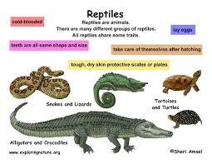
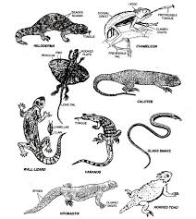
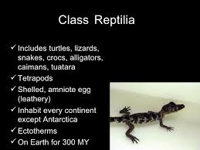
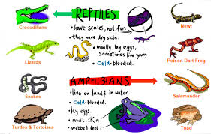
Some Pictures……….

Slide 9
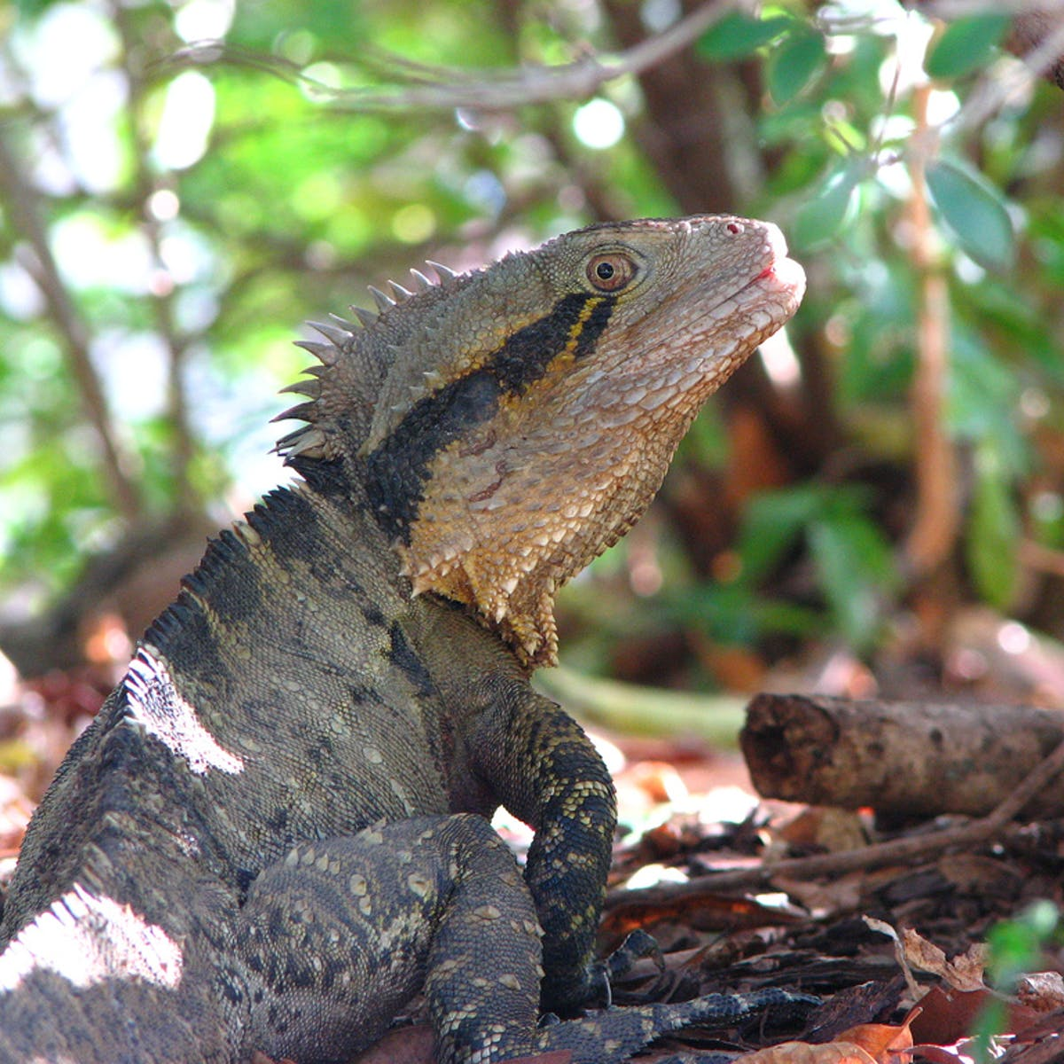
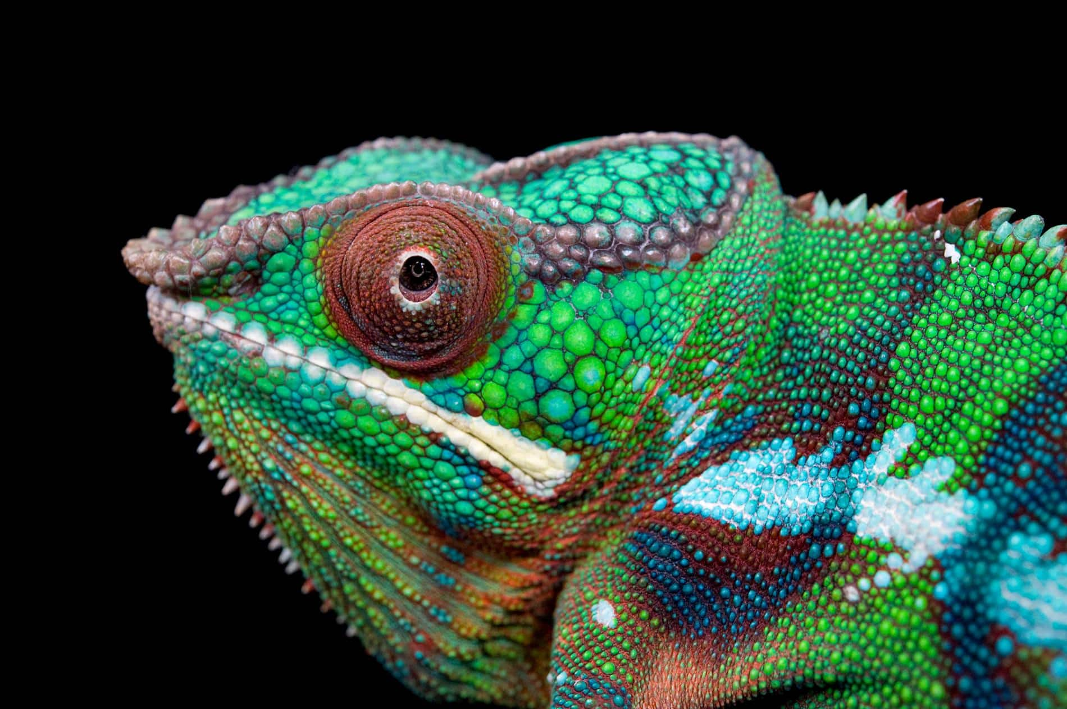
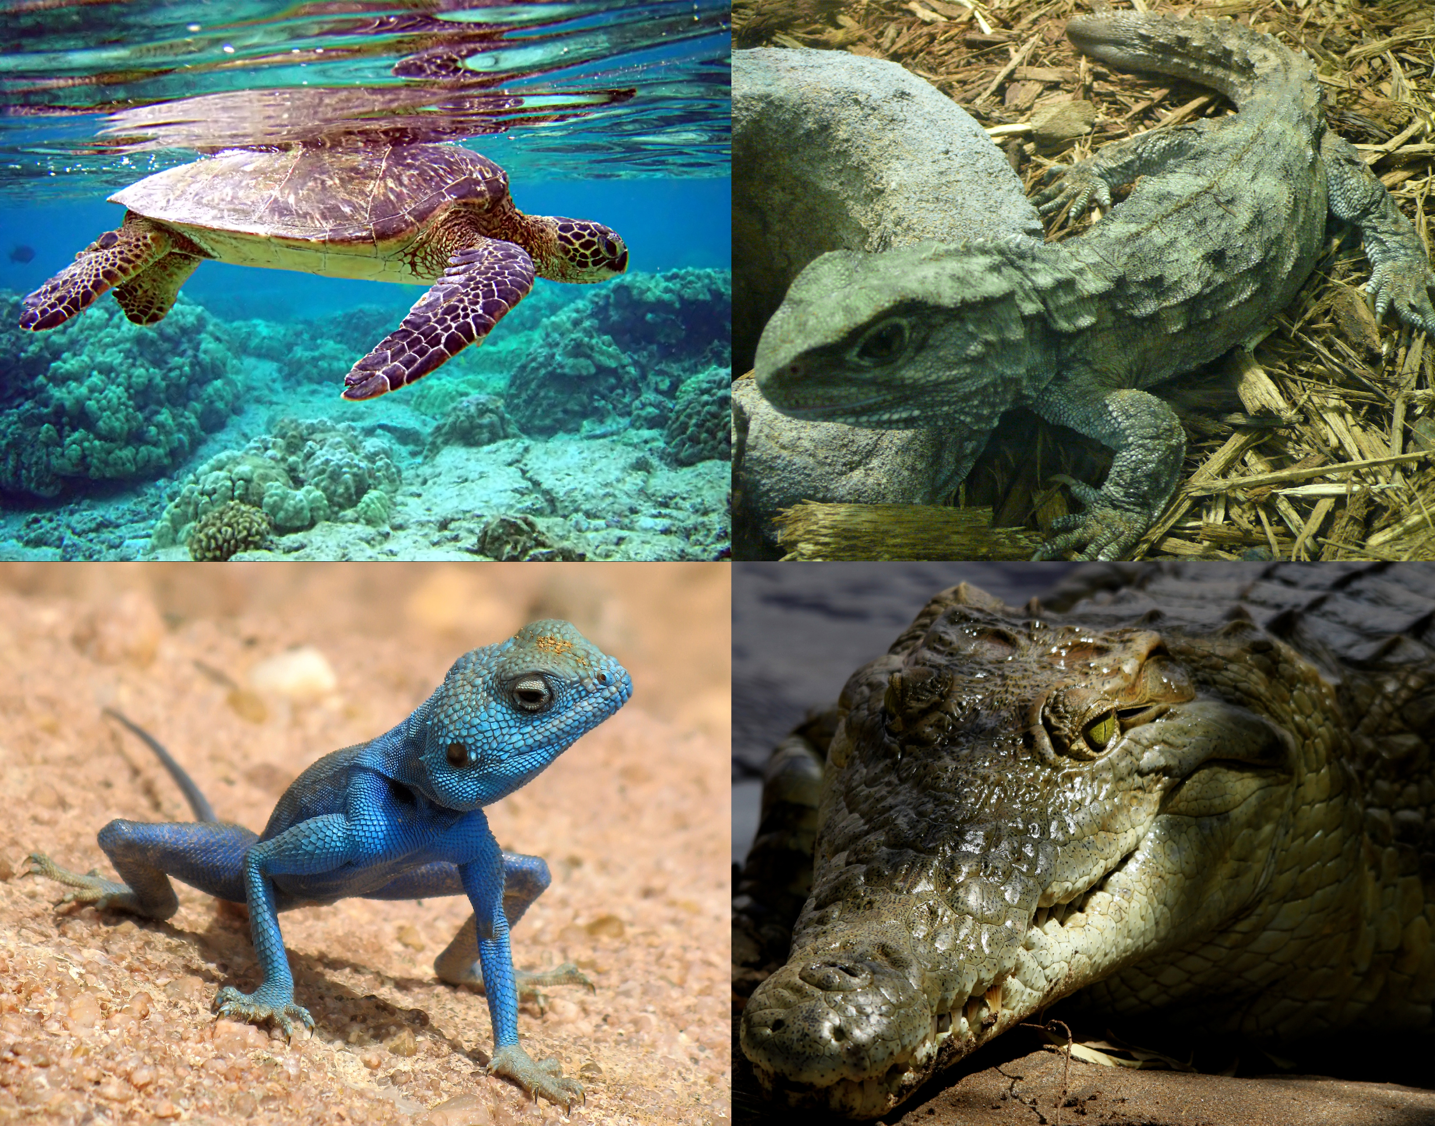

Slide 10
Reference
https://byjus.com/biology/reptilia/#:~:text=Characteristics%20of%20Reptilia&text=These%20are%20creeping%20and%20burrowing,neck%2C%20trunk%2C%20and%20tail.
https://www.google.com/url?sa=i&url=https%3A%2F%2Fwww.slideshare.net%2FerinNly%2Fclass-reptilia&psig=AOvVaw3Zrkla2sz_T5BmQogFCBGU&ust=1611741514147000&source=images&cd=vfe&ved=2ahUKEwj7idGUq7nuAhWbTSsKHZA9ALYQr4kDegUIARCmAQ

Slide 11
Thank You

